Slide 1

Reveal, Don’t Conceal Rethinking Data Visualization & Statistics Education to Improve Transparency
Tracey L. Weissgerber, PhD
Twitter: @T_Weissgerber

Slide 2
Why focus on small datasets?
Common in basic biomedical and biological sciences, translational science
Influence decisions about what potential treatments advance to clinic trials, further research
NIH highlighted problems with reproducibility, especially in preclinical research

Slide 3
Overview
Data viz & stats in basic science
Problems with current practices
Why does this happen?
Solutions
Ongoing research: Other topics
Animal models of preeclampsia
eLife Ambassadors meta-research group

Slide 4
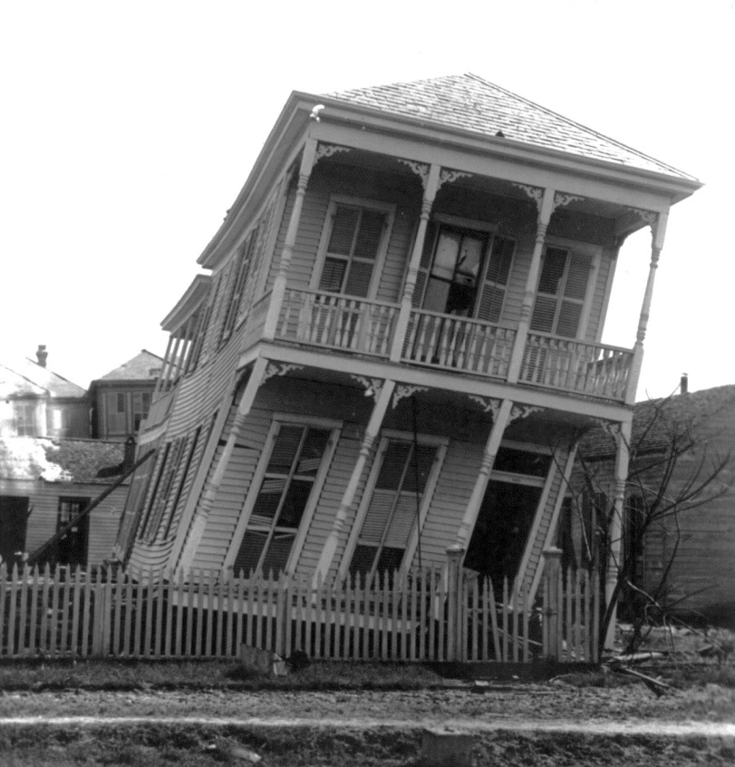
Data presentation is the foundation of our collective scientific knowledge…
Figures are especially important.
They often show data for key findings.

Slide 5
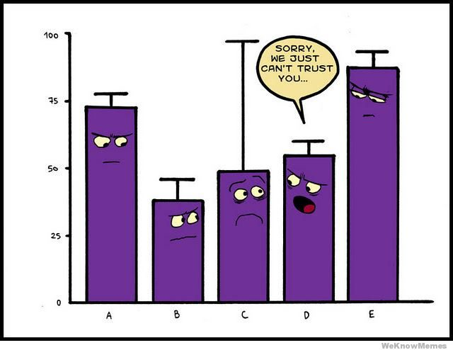
Effective figures should:
Immediately convey information about the study design
Illustrate important findings
Allow the reader to critically evaluate the data & analysis strategy

Slide 6

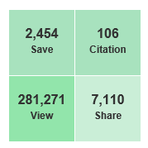

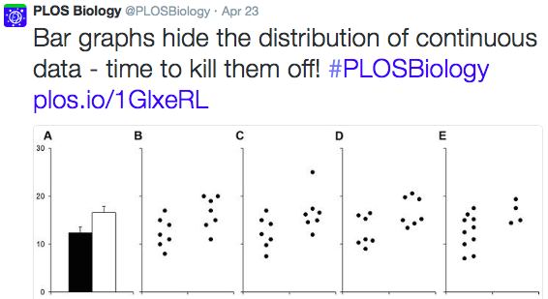

Slide 7
Key Findings: Systematic Review
Almost all papers use bar and line graphs to present continuous data
Impossible to critically evaluate the data
Sample sizes are very small (n<10 / group)
78% of bar graphs show mean SE
>50% of papers that use non-parametric analysis present data as mean SE or mean SD

Slide 8
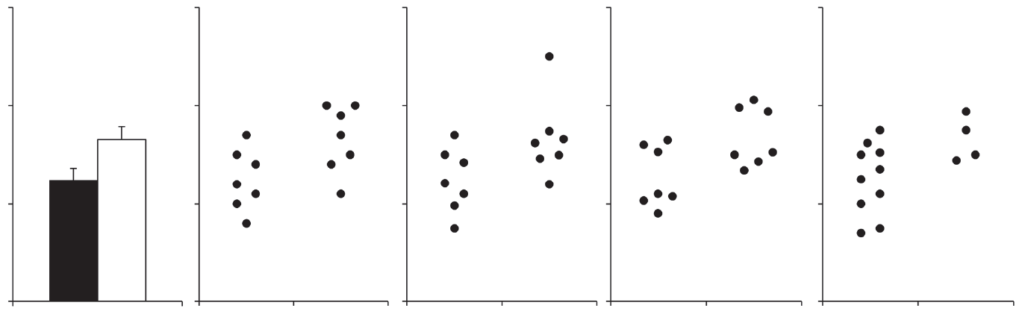
Many different data distributions can lead to the same bar graph…
Symmetric
Outlier
Bimodal
Unequal n
30
20
10
0
Test | p value
T-test: equal var. | 0.035 | 0.074 | 0.033 | 0.051
T-test: Unequal var. | 0.035 | 0.076 | 0.033 | 0.035
Wilcoxon | 0.056 | 0.10 | 0.173 | 0.067

Slide 9
Why you shouldn’t use a bar graph even if your data are normally distributed
Bar graph
(mean ± SE)
Bar graph
with points
Dotplot
Zone of Invisibility
Range of
Observed
Values
Zone of
Irrelevance
0
Bar graphs
Don’t allow you to critically evaluate continuous data
Arbitrarily assign importance to bar height, rather than focusing on how the difference between means compares to the variability in the data

Slide 10
Our interpretation depends on what we see
Reader is a passive observer
Reader is an active participant
Mean ± SE

Slide 11

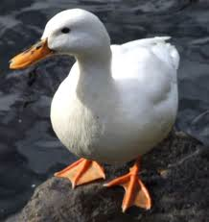
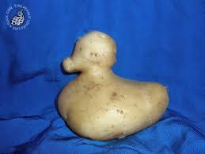
All data presentation methods are a reflection of reality…
Select methods that minimize distortion

Slide 12
Problem: Very vague statistical methods
“Data were analyzed by t-test or ANOVA, as appropriate…”
Can we tell what type of ANOVA or t-test is being performed?
Do we have the information needed to verify the test result (test statistic, DF, exact p-value)?
Common errors

Slide 13
Overview
Data viz & stats in basic science
Problems with current practices
Why does this happen?
Solutions
Ongoing research: Other topics
Animal models of preeclampsia
eLife Ambassadors meta-research group

Slide 14

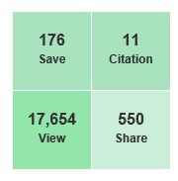
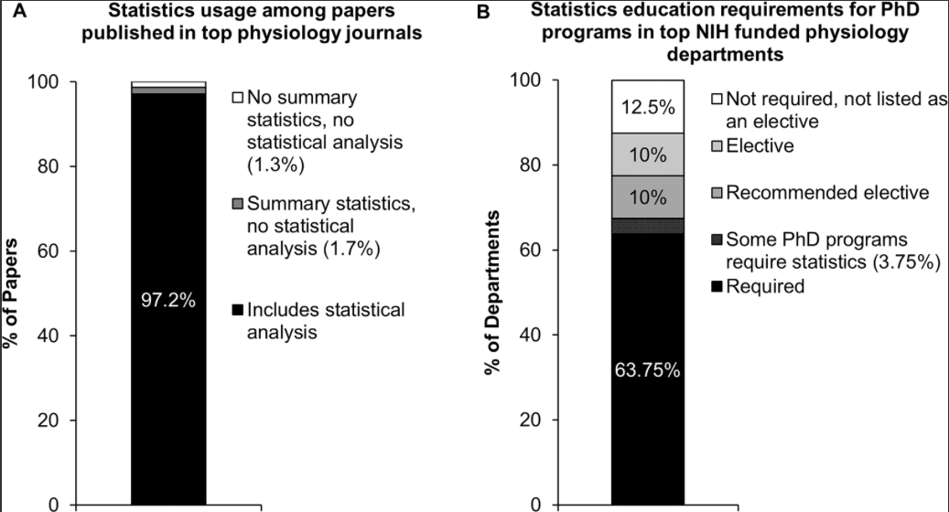
Statistics are essential, but training is not always required for a PhD
n = 703
n = 80

Slide 15
Overview
Data viz & stats in basic science
Problems with current practices
Why does this happen?
Solutions
Ongoing research: Other topics
Animal models of preeclampsia
eLife Ambassadors meta-research group

Slide 16
Developing new statistics curriculum
Data visualization first, statistics second
Target misconceptions & missed skills
Visual simulation tools instead of equations

Slide 17
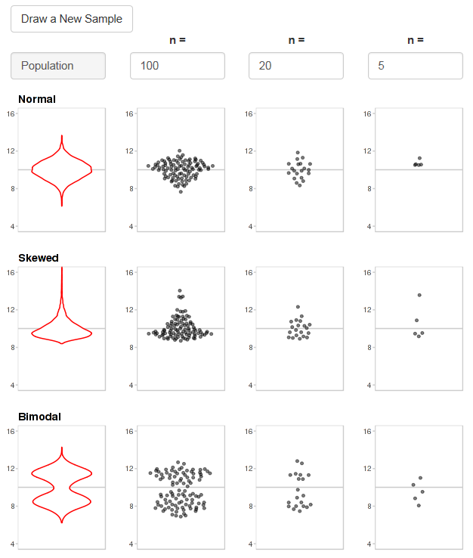

Slide 18
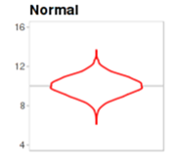
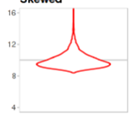
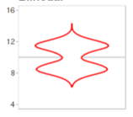
If we draw 100 samples, how many would fail a normality test?
Expected | ~5% | ~100% | ~100%
n = 100 | 6% | 100% | 100%
n = 20 | 5% | 55% | 53%
n = 5 | 7% | 10% | 12%
Normal
Skewed
Bimodal

Slide 19
Summary statistics are only meaningful when there are enough data to summarize
100 random samples
n = 5 / sample
100 random samples
n = 20 / sample
Population mean ± SD
With small sample sizes, means and SDs can be very inaccurate

Slide 20
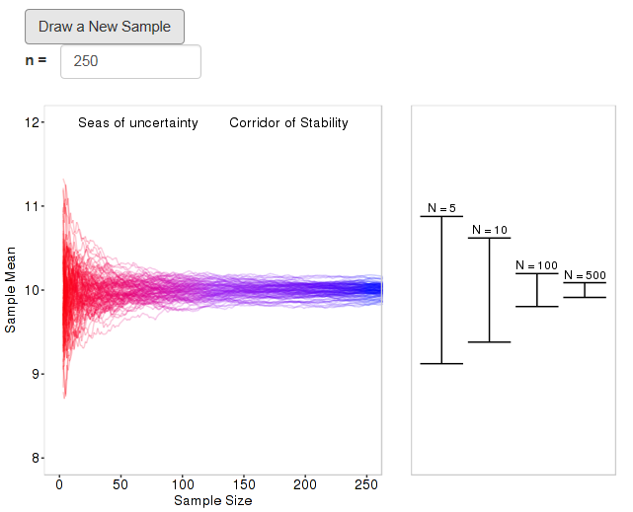
Seas of
uncertainty
Corridor of
stability

Slide 21


Objective:
Create tools needed to transform scientific publications from
static reports into interactive datasets

Slide 22
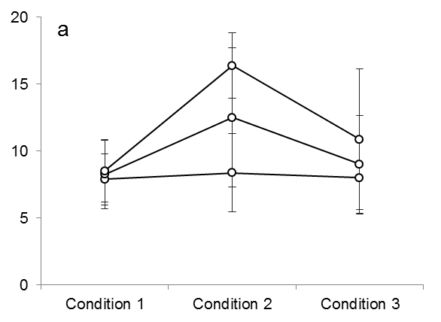
Example: The line graph
Scientists want to know 2 things:
How much do different groups overlap?
Do all individuals in a group follow the same response pattern?
Difficult or impossible to
determine with
a static line graph

Slide 23
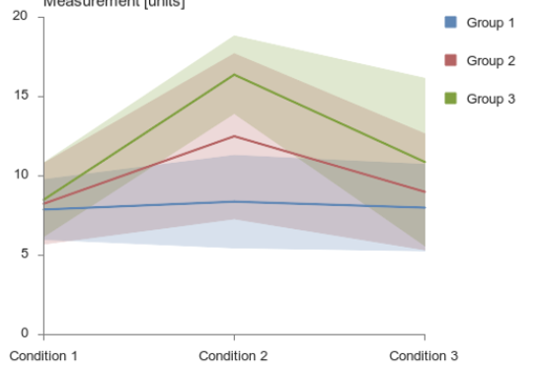
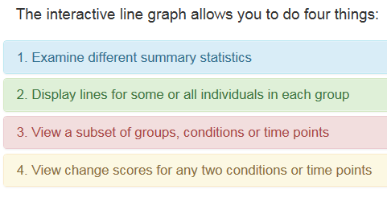
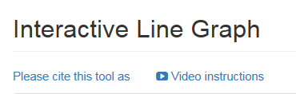
Solution: Interactive Line Graph
http://statistika.mfub.bg.ac.rs/interactive-graph/

Slide 24

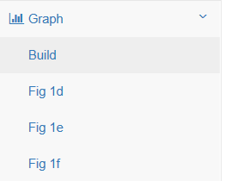
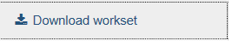
Features for Publications
1
Save any static graph that you want to include in your paper
Saved graphs appear in the “Build” menu. Readers can explore the entire dataset or click on a saved graph to explore a specific figure from your paper.
You can download:
csv datafile
Tiff files for saved static graphs
Xml file of interactive graphic to include in paper supplement
2
3

Slide 25

Interactive Dotplot http://statistika.mfub.bg.ac.rs/interactive-dotplot/
View different types of graphs
Examine subgroups (i.e. male vs. female)
Examine clusters of non-independent data

Slide 26
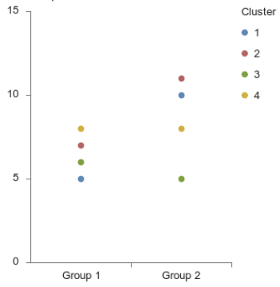
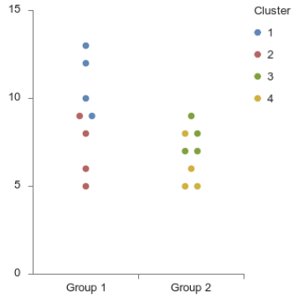
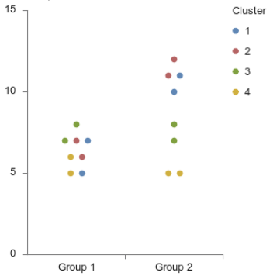

Clusters of Non-independent Data: Visualization & Analyses Depend on Design
Figures | a Between-Group Clusters | b Within-Group Clusters | c Between and Within Group Clusters
Design
Measurements per subject or specimen | 1 | 1 | 1
Non-independent data? | Yes: Between Groups Each subject or specimen in Group 1 is related or matched to one subject or specimen in Group 2 | Yes: Within Group Some subjects or specimens within each group are related to each other | Yes: Within & Between Groups Subjects or specimens in Group 1 are related to other subjects or specimens in Group 1 as well as some subjects or specimens in Group 2
Example | One pup from each litter is assigned to Group 1, while a second pup from each litter is assigned to Group 2 | Pups from 2 litters are assigned to Group 1, while pups from 2 different litters are assigned to Group 2 | Two or more pups from each litter are assigned to Group 1, while other pups from the same litter are assigned to Group 2
15
Cluster
15
Cluster
15
Cluster
1
1
1
2
2
2
3
3
3
10
4
10
4
10
4
5
5
5
0
Group 1
Group 2
0
Group 1
Group 2
0
Group 1
Group 2
Group 1
Group 2
Group 1
Group 2
Group 1
Group 2

Slide 27
Sex Differences
NIH & CIHR policies:
Consider sex as a biological variable
Studies not designed & powered to detect sex differences
Knowledge gap
Design
Analysis
Interpretation
Editors, reviewers: Incentive to request unplanned, underpowered analysis
Spurious findings
Over-interpretation of underpowered studies

Slide 28
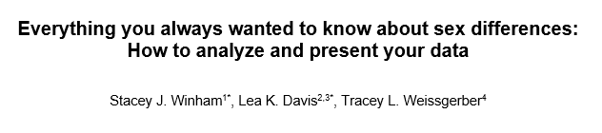
Fixing the Knowledge Gap
Objective
Provide an accessible overview of strategies for presenting and analyzing data from preclinical studies that include males & females (exploratory & confirmatory)

Slide 29
Overview
Data viz & stats in basic science
Problems with current practices
Why does this happen?
Solutions
Ongoing research
Animal models of preeclampsia
eLife Ambassadors meta-research group

Slide 30
Preeclampsia: Animal Models
Quality of design & reporting
ARRIVE guidelines: Improvements with time?
Visualization
Handling clustered data
Preeclampsia specific issues
How often are defining preeclampsia characteristics measured / reported?
Can we tell how strong & consistent the phenotypes are?
Translation: Models target specific pathways, pathophysiology in women is very diverse

Slide 31
Preeclampsia: Animal Models
≈ 500 papers that used animal models to study preeclampsia
Jan. 2000 - Sept. 2016
No language restrictions
Abstracting data
All models: model, species, purpose of study, agent for preclinical studies
Models with >20 papers (≈400 papers): Detailed information on methodology & reporting

Slide 32
eLife Ambassadors Meta-research Team
Members learn by working together to design, conduct & publish a meta-research study
Quality of reporting for microscopy images
Proposals & protocols for independent projects
Created meta-research reading lists for other teams:
Pre-prints & peer review journal clubs
Reproducibility workshops

Slide 33
Acknowledgements
Mayo Clinic
Stacey Winham
Ethan Heinzen
Oscar Garcia-Valencia
Vesna Garovic
University of Belgrade
Natasa Milic
Marko Savic
Jelena Milin-Lazovic
Funding
AHA 16GRNT30950002
Robert W. Fulk Career Development Fund
NIH BIRCWH K12HD065987
NCATS UL1 TR000135
NICHD P-50 AG44170

Slide 34
Questions…? Comments…? Emotional Outbursts…?

Slide 35
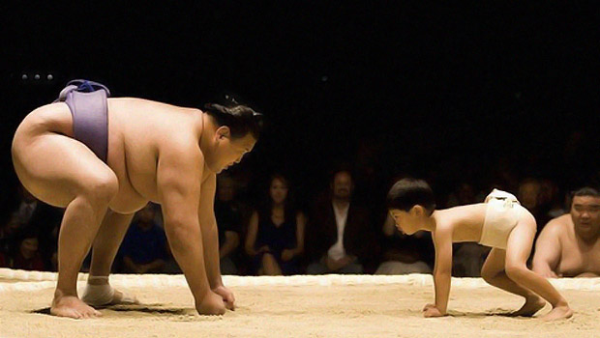
Changing data presentation for continuous variables in small sample sizes is critical to promote transparency

Slide 36
What can you do?
Banish bar graphs from your papers
and talks
Reviewers & editors: Request figures that show
data distributions
Talk to editors about improving data presentation in their journals
Work with statistics instructors to organize data presentation & statistics training for trainees, junior investigators and senior researchers

Slide 37

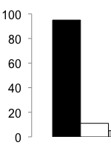
Bar graphs are designed for categorical data
Categorical variable
Single value
Continuous variable
Sample size > 1
Central tendency
Variation

Slide 38
Bar Graph = Visual Table
Group | Outcome
Black Bar | 12.4 ± 1.6
White Bar | 17.5 ± 1.9
Values are mean ± SE
No additional information about distribution
Weissgerber et al, PLOS Biology 2015

Slide 39

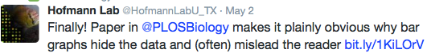
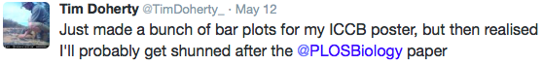
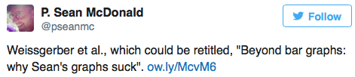
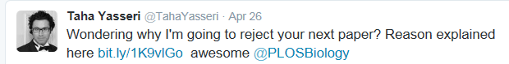

Slide 40
Additional problems with bar graphs for paired data…
a
b
c
d
Symmetric
Skewed
Bimodal
Differences Between
Paired Measurements
Weissgerber et al, PLOS Biology 2015

Slide 41

SE, SD or scatterplots: Our interpretation depends on what we see
SE looks similar between groups
SD = SE*√n

Slide 42
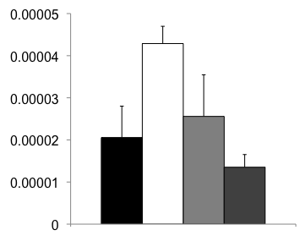
SE depends on sample size: Misleading with unequal n’s
5
3
6
6
Mean ± SE
Mean ± SD

Slide 43
Scatter plot immediately conveys critical information
Very small sample sizes
Possible bimodal distribution…?
Outlier
Unequal variance

Slide 44
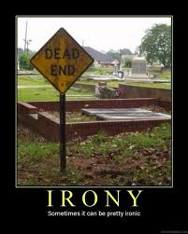
Irony Alert…
This presentation argues that bar graphs are not the best method for presenting continuous variables…
…using data presented in bar graphs

Slide 45
Bar and line graphs are preferred for showing continuous data
Articles with
≥1 figure of the
type listed
(% of 631 articles)
Bar graph
Box plot
Scatterplot
Histogram
Line graph, point
& error bars plot

Slide 46
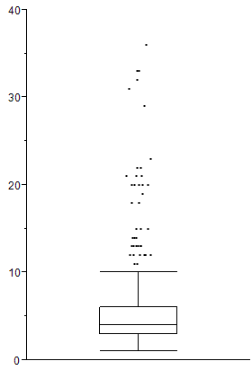
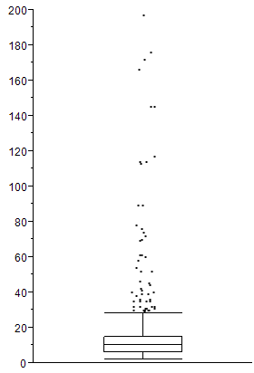
Samples sizes are small…
40
Median: 4
IQR: 3 - 6
220
Median: 10
IQR: 6 - 15
200
180
30
160
120
Minimum Sample Size / Group
100
20
Maximum Sample Size / Group
80
60
10
40
20
0
0
Similar results in studies with only
parametric analyses

Slide 47
Most bar graphs show mean ± SE
SD
15%
% of 541
articles with
≥1 bar graph
Mean
97%
SE
78%

Slide 48
Many papers are missing critical information needed to determine what type of ANOVA was used
1. Maximum number of
factors in ANOVA
2. Specified what factors
were included in
each ANOVA
3. Specified post-hoc
tests
% of papers that included
ANOVA (n = 225)

Slide 49
Many papers are missing critical information needed to determine what type of ANOVA was used
Specified between (independent) vs.
within (non-independent) subjects factors
Papers that reported using
RM ANOVA
(n = 41)
Papers that did not report
using RM ANOVA
(n = 184)
% of papers
68.5%

Slide 50
Fewer than 5% of papers report details needed to verify the test result
1. Reported
F-statistic
2. Reported degrees
of freedom
3. Reported
exact p-values
No
95.1%
No
96.9%
No
77.8%
% of papers that
included ANOVA (n = 225)

Slide 51
Making effective dotplots
Dotplots are useful for comparing values of a continuous variable across study groups (cross-sectional study or experimental study with independent groups)
Dotplots are the best choice for small datasets. The summary statistics shown in box plots and violin plots are only meaningful if you have enough data to summarize.
A: Ineffective graph
B: Decrease point size
C: Semi-transparent
points
D: Random jitter
E: Symmetric jitter
Step 1: Make all data points visible
A: Ineffective graphic
B: Increase width
C: Emphasize summary statistics
Step 2: Emphasize summary statistics

Slide 52
Objective:
Create tools needed to transform scientific publications from
static reports into interactive datasets

Slide 53
Example: The line graph
Scientists want to know 2 things:
How much do different groups overlap?
Do all individuals in a group follow the same response pattern?
Difficult or impossible to
determine with
a static line graph

Slide 54
Solution: Interactive Line Graph
http://statistika.mfub.bg.ac.rs/interactive-graph/
Link to video tutorial on site

Slide 55
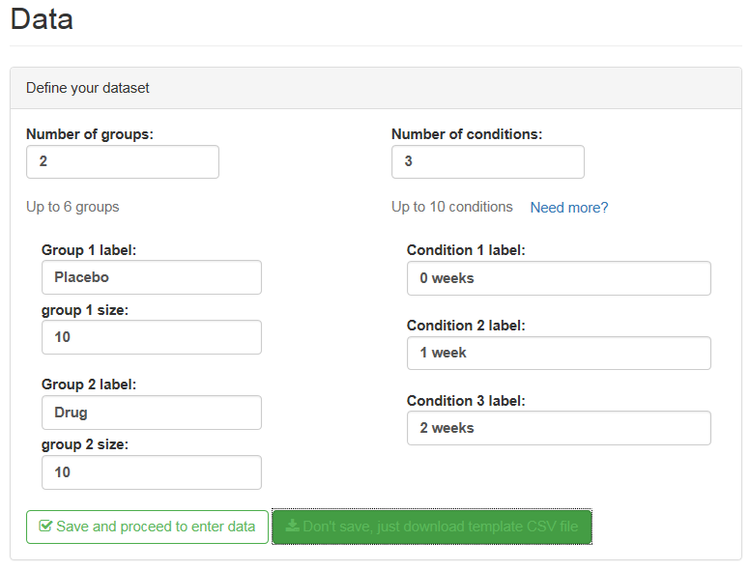
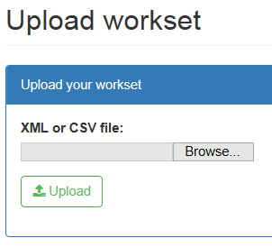
Two Options for Easy Data Entry
1. Manual data entry
2. Upload csv file
Download template csv file

Slide 56
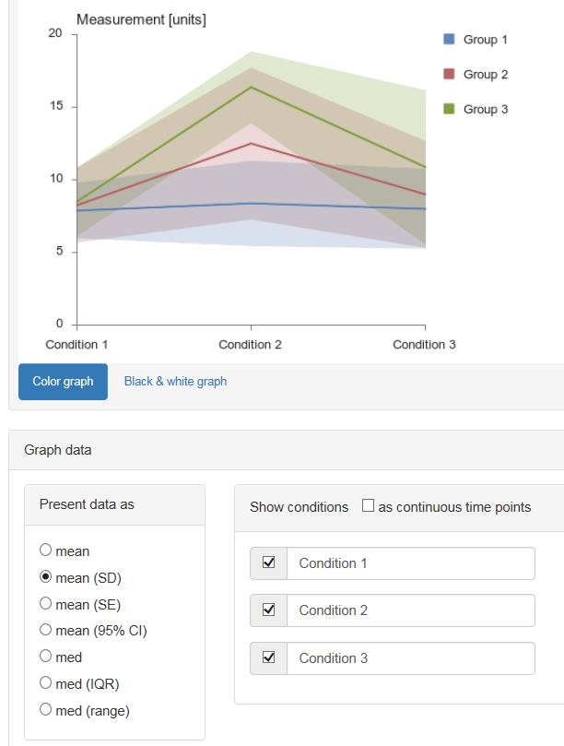
View different summary statistics
Semi-transparent shading: Easy to assess overlap between groups
Select any option; graph automatically updates

Slide 57
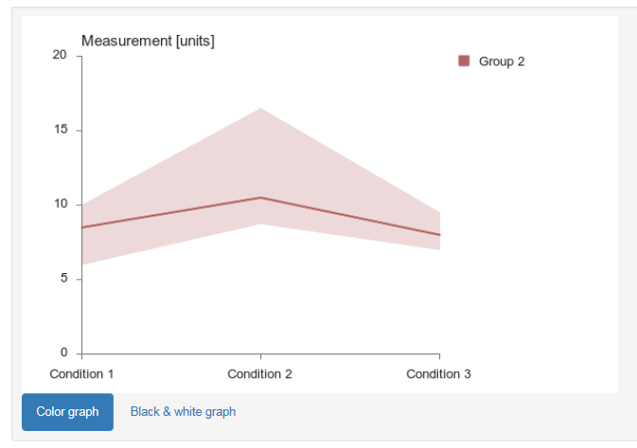
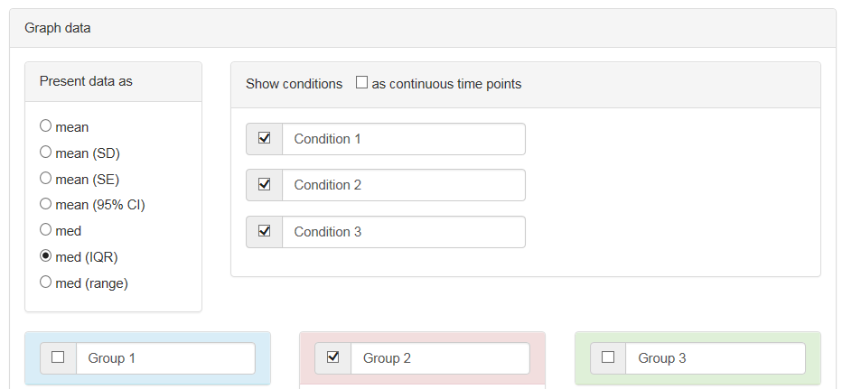
Focus on specific groups, conditions or time points
Uncheck the box next to any group or condition to delete it from the graph

Slide 58
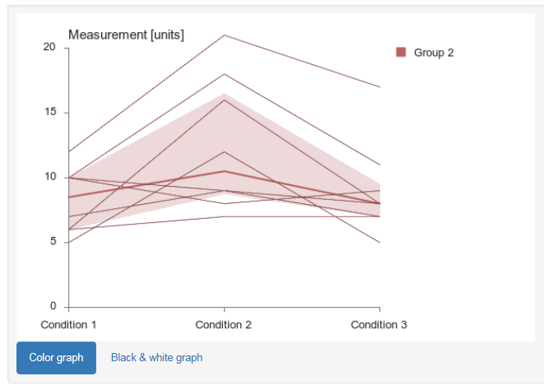
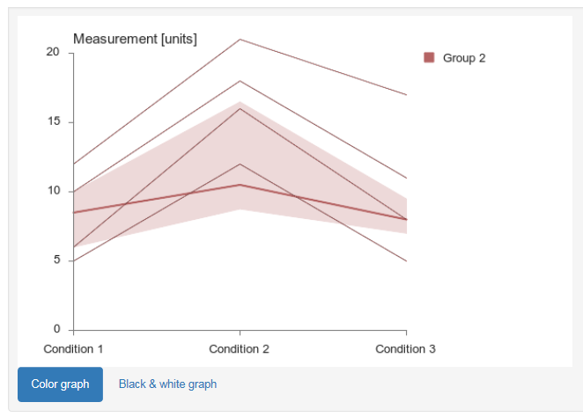
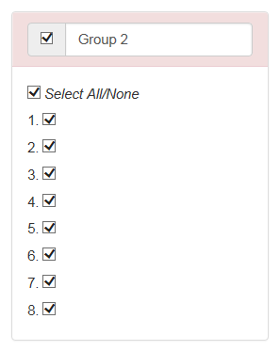
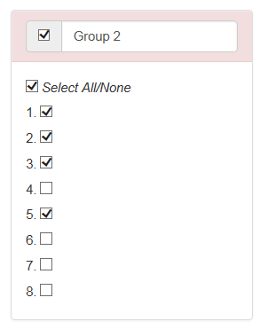
View lines for any individual
Check boxes to view individual lines

Slide 59
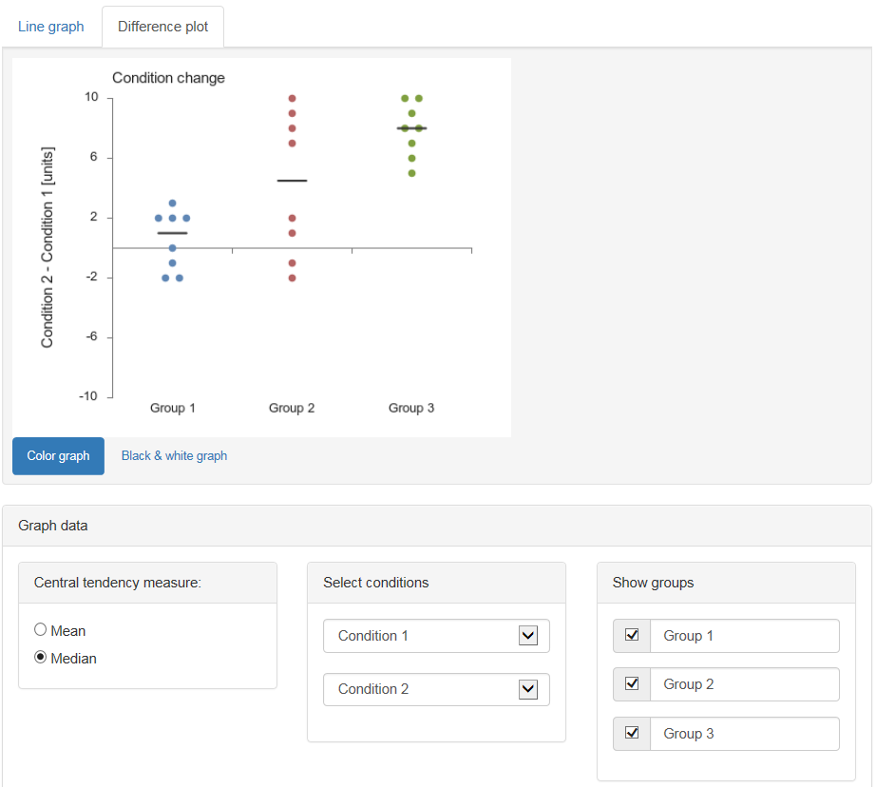
View change scores for any 2 conditions / time points
Difference plot tab
Change summary line
Change conditions
Show / hide groups

Slide 60
Features for Publications
1
Save any static graph that you want to include in your paper
Saved graphs appear in the “Build” menu. Readers can explore the entire dataset or click on a saved graph to explore a specific figure from your paper.
You can download:
csv datafile
Tiff files for saved static graphs
Xml file of interactive graphic to include in paper supplement
2
3

Slide 61
Interactive Dotplot http://statistika.mfub.bg.ac.rs/interactive-dotplot/
View different types of graphs
Examine subgroups (i.e. male vs. female)
Examine clusters of non-independent data

Slide 62
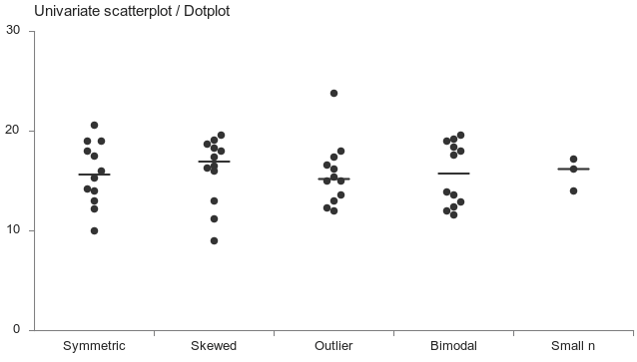
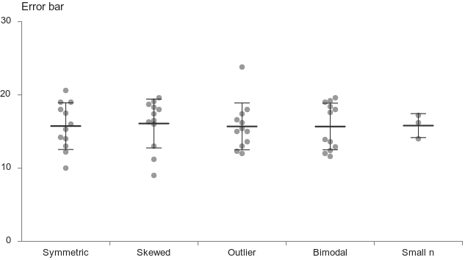
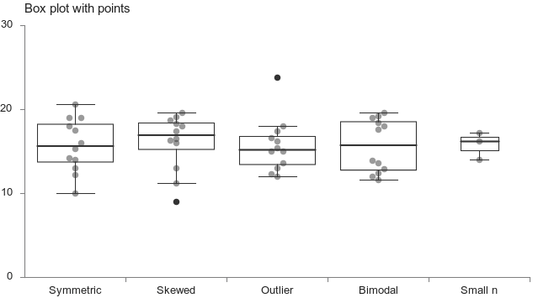
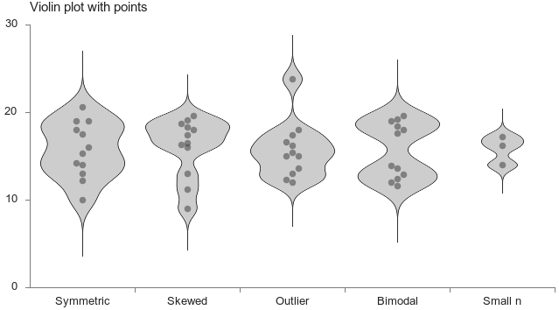
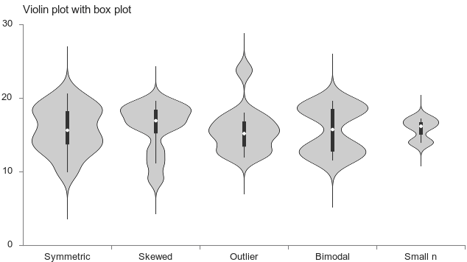
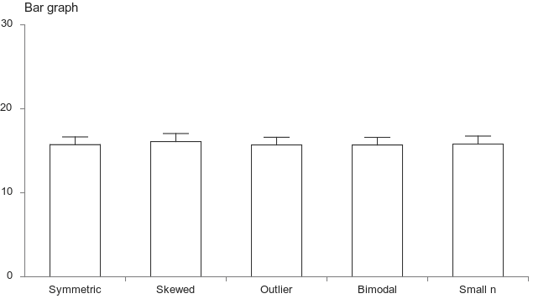


View different types of graphs
30
30
20
20
10
10
0
Symmetric
Skewed
Outlier
Bimodal
0
Symmetric
Skewed
Outlier
Bimodal
30
30
30
20
20
20
10
10
10
0
Symmetric
Skewed
Outlier
Bimodal
0
Symmetric
Skewed
Outlier
Bimodal
0
Symmetric
Skewed
Outlier
Bimodal
30
30
20
20
10
10
0
Symmetric
Skewed
Outlier
Bimodal
0
Symmetric
Skewed
Outlier
Bimodal

Slide 63



Examine subgroups (i.e. male vs. female)

Slide 64
Show clusters of non-independent data (replicates, mice from the same litter)
Between-Group Clusters
Within-Group Clusters
Between & Within-Group Clusters

Slide 65
A: No difference between wild type and knockout mice
Bar graph
mean ± SE, males and
females pooled
No sex differences
Sex difference in
one group
Sex difference in
both groups
Not enough females
to draw conclusions
Wild type
Knockout
Wild type
Knockout
Wild type
Knockout
Wild type
Knockout
B: Difference between wild type and knockout mice
Bar graph
mean ± SE, males and
females pooled
No sex difference
Sex difference in
one group
Apparent difference between
groups is actually
due to a sex difference
Wild type
Knockout
Wild type
Knockout
Wild type
Knockout

Slide 66
Pooled Analysis
Stratified Analysis
Test for Interaction
Minimum sample size, power & statistical complexity
 | Pool Males & Females | Stratified Analysis | Test for Interaction
Research question | Is there an effect of group overall? | Within a given sex, what is the effect of group? | Does the effect of group differ between sexes?
Example | Are WT and KO mice different? | Within males, is there a difference between WT and KO mice? Within females, is there a difference between WT and KO mice? | Does the difference between WT and KO mice depend on whether the mice are male or female?
What can you conclude? | There is (or is not) a difference between WT and KO mice | Within males, there is (or is not) a difference between WT and KO mice Within females, there is (or is not) a difference between WT and KO mice | Example: The is a difference between WT and KO mice in females, but not in males
Best conditions for using this technique | You don’t have enough observations from each sex for a stratified or interaction analysis | You have enough observations of at least one sex in both groups for an adequately powered analysis | You have enough observations of both sexes in both groups for an adequately powered analysis
Cautions & Limitations | If you don’t have enough data for a stratified or interaction analysis, acknowledge this limitation rather than stating that males and females were pooled because no sex differences were found. This is particularly important if previous studies have shown that sex differences exist, or have not tested for sex differences. | Don’t claim there is a sex difference if there is a significant effect of group in one sex but not the other, especially if power is higher one sex | You must have observations from both sexes in all groups
Tables | One table with three separate columns (female, male, pooled) | Separate tables for females and males | One table with separate columns for females and males
Figures | One figure showing pooled data and summary statistics, with different colors for females and males | Separate figures for female and male Same axis scales to facilitate visual comparison | One figure showing females and males as separate groups
 | Female | Male | Pooled
WT | 8 ± 5 | 10 ± 5 | 10 ± 5
KO | 18 ± 4 | 20 ± 4 | 19 ± 4
 | Female
WT | 8 ± 5
KO | 18 ± 4
 | Male
WT | 10 ± 5
KO | 20 ± 4
 | Female | Male
WT | 8 ± 4 | 8 ± 4
KO | 23 ± 4 | 8 ± 4
WT
KO
WT
KO
WT
KO
WT
KO
WT
KO

Slide 67
Error in Sample Mean | n = 5 / sample | n = 20 / sample
>1 SD | 2.2% | 0.0%
0.75 to 1 SD | 6.0% | 0.1%
0.5 to 0.75 SD | 16.0% | 2.9%
0.25 to 0.5 SD | 33.1% | 24.2%
< 0.25 SD | 42.7% | 72.8%
1.40
n = 5 / sample
n = 20 / sample
1.25
Sample mean is
>1 SD away from
population mean
Very large
error
1.00
0.75
Sample Mean - Population Mean
(Absolute Difference in units of SD)
0.50
0.25
Sample mean is
within 0.25 SD of
population mean
Small
error
0
20
10

Slide 68


Slide 69
Products
Dataset
Share via customized website
Searchable by model, species, preclinical agent
Add papers after Sept. 2016…?
Papers
Reporting & experimental quality
Preeclampsia-specific issues
RUPP model: Variability in & relationship between phenotypic characteristics

Slide 70
 | Measurements per subject or specimen | Non-independent data? | Example
A: Independent
 | 1 | No: Independent No subjects or specimens are related to each other | Eight pups from 8 different mothers are each assigned to Group 1 or Group 2 (n=4/group)
B: Longitudinal/Repeated Measures
 | 2+ | Yes: Within Subject Multiple measurements/subject or specimen; Design may also include 2 or more groups | Longitudinal studies The same samples are tested under different conditions
C: Between Group Clusters
 | 1 | Yes: Between Groups Each subject or specimen in Group 1 is related or matched to one subject or specimen in Group 2 | One pup from each litter is assigned to Group 1, while a second pup from each litter is assigned to Group 2
D: Within Group Clusters
 | 1 | Yes: Within Group Some subjects or specimens within each group are related to each other | Pups from 2 litters are assigned to Group 1, while pups from 2 different litters are assigned to Group 2
E: Between and Within Group Clusters
 | 1 | Yes: Within & Between Groups Subjects or specimens in Group 1 are related to other subjects or specimens in Group 1 as well as some subjects or specimens in Group 2 | Two or more pups from each litter are assigned to Group 1, while other pups from the same litter are assigned to Group 2
Group 1
Group 2
Time or Condition 1
Time or Condition 2
Group 1
Group 2
Group 1
Group 2
Group 1
Group 2
Source: Transparent Reporting for Reproducible Science http://onlinelibrary.wiley.com/doi/10.1002/jnr.23785/pdf

